Slide 1




ASP.NET Unit Testing
Unit Testing Web API
ASP.NET
Unit Testing
SoftUni Team
Technical Trainers
Software University
http://softuni.bg

Slide 2
Have a Question?
sli.do #CSharpWeb

Slide 3
Table of Contents
Ways to Test a Web Service
Unit Testing
Testing the Web Service Layers
Unit Testing the Data Layer
Unit Testing the Repositories Layer
Unit Testing the Services (Controllers)

Slide 4


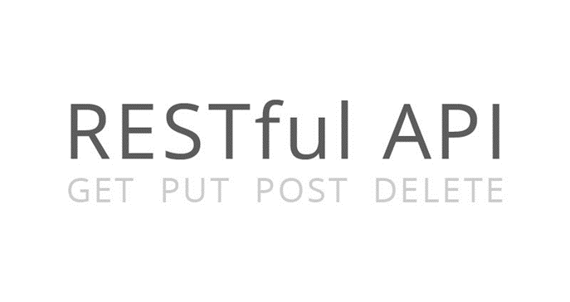
Web Service Testing
testing

Slide 5

Web Service Unit Testing
Web service unit testing is much like a regular unit testing
Writing test methods to test classes and their methods
A REST service is build from many more components
Data objects (POCO, data access logic)
HTTP status codes
HTTP response objects
Media types, JSON, XML
Access permissions, etc…
testing

Slide 6
WS Unit Testing
Levels of Web service testing:
Write unit tests to test the C# classes / logic
Test all objects, their constructors, properties and methods
Test the data access layer and repositories (CRUD operations)
Test the services / controllers (mock the database operations)

Slide 7



Unit Testing the Service Layer (Web API Controllers)
testing

Slide 8
Unit Testing the Service Layer
Testing the service layer actually means
Testing the Web API controllers and the REST API
Two main things to test:
Test if the controllers work correctly as C# classes
Using mocking or fake repositories to avoid database operations
Test if the endpoints of the REST services return data correctly
Check the HTTP status code and the returned content (JSON / XML)

Slide 9
Unit Testing Controllers with Fake Repositories
Repositories may be faked (mocked)
Or use a mocking framework like Moq, FakeItEasy, JustMock, …
Mocking the repositories
Separates the controller testing from the data store testing
Mocked tests run faster, but catch less bugs
Integration tests (without mocks)
More complex, run slower, but catch more problems

Slide 10
Testing the returned status code
In our controllers we return a IHttpActionResult which can give us information about the returned StatusCode and ViewModel.
In the unit test we can handle this in by receiving and HttpResult from System.Web.Http.Results.
From it we can extract the response and even check response header if needed

Slide 11
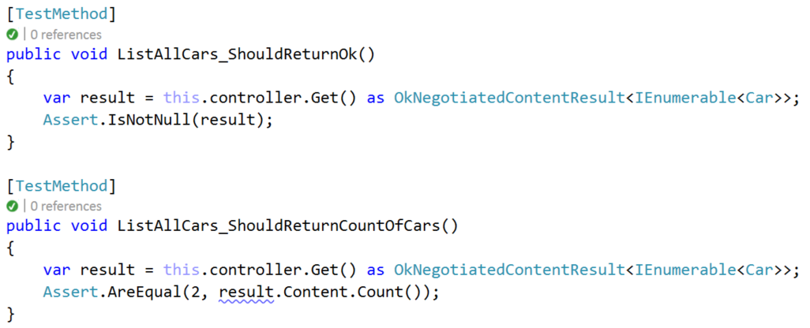
Testing negotiated content result

Slide 12
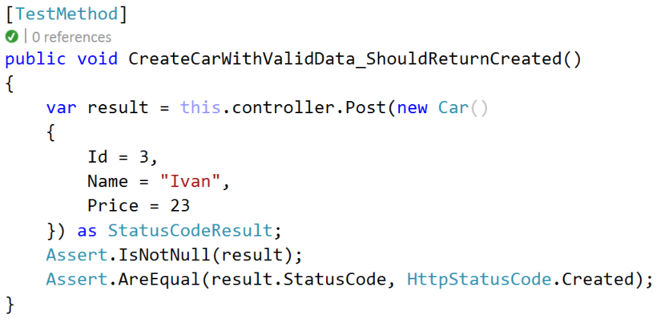
Testing status code

Slide 13
Testing Model State Validation
Since ModelState.IsValid is called when the application is binding our request parameters to a binding object, we cannot have an adequate ModelState while testing. Therefore we have 2 options:
Trust that the ModelState validation works correctly and not test it
Call the Validate method of the controller explicitly in the unit test

Slide 14
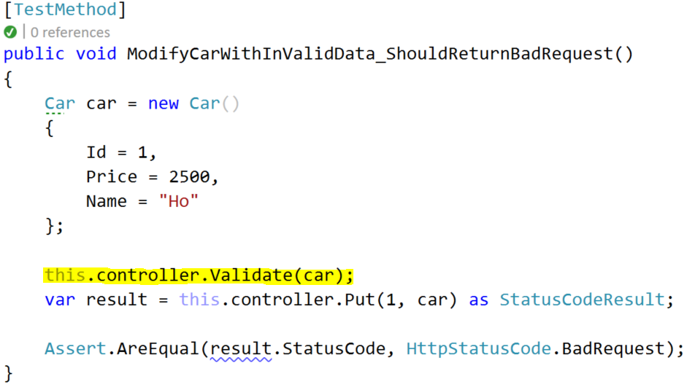
Testing Model State Validation (Example)
Here the Car name should has a MinLenght of 3

Slide 15
Mocking the DbSet
First you need to create an interface for the current DBContext
public class FakeDbSet<T> : DbSet<T>, IEnumerable<T>, IQueryable where T : class
{
private HashSet<T> set;
private IQueryable _query;
public FakeDbSet()
{
this.set = new HashSet<T>();
this._query = this.set.AsQueryable();
}

Slide 16
Mocking the DbSet (2)
public override T Add(T entity)
{
this.set.Add(entity);
return entity;
}
public override T Remove(T entity)
{
this.set.Remove(entity);
return entity;
}

Slide 17
Mocking the DbSet (3)
System.Linq.Expressions.Expression IQueryable.Expression
{
get { return this._query.Expression; }
}
IQueryProvider IQueryable.Provider
{
get { return this._query.Provider; }
}

Slide 18
Mocking the DbSet (4)
System.Collections.IEnumerator System.Collections.IEnumerable.GetEnumerator()
{
return this.set.GetEnumerator();
}
IEnumerator<T> IEnumerable<T>.GetEnumerator()
{
return this.set.GetEnumerator();
}

Slide 19
Mocking the DbContex
We will need an interface for the database, because we would like to inject it and mock it in the tests
public interface INewsContext
{
DbSet<News> News { get; }
int SaveChanges();
}

Slide 20
Mocking the DbContex (2)
Next implement that interface in the original DbContext and in the FakeDbContext, using the FakeDbSet
public class FakeNewsContext : INewsContext
{
public FakeNewsContext()
{ this.News = new FakeNewsDbSet(); }
public DbSet<News> News { get; }
public int SaveChanges() { return 0; }
}

Slide 21
Mocking the DbContex (3)
Now we can easily Inject the original DbContext in the Service
public Service(INewsContext context) { this.Context = context; }
protected INewsContext Context { get; }
And also we can put the fake implementation of the DbContext when instantiating the service in the Unit test
FakeNewsContext context = new FakeNewsContext();
NewsController controller = new NewsController(new NewsService(context));

Slide 22








ASP.NET Unit Testing
https://softuni.bg/courses/

Slide 23
License
This course (slides, examples, demos, videos, homework, etc.) is licensed under the "Creative Commons Attribution-NonCommercial-ShareAlike 4.0 International" license

Slide 24






Free Trainings @ Software University
Software University Foundation – softuni.org
Software University – High-Quality Education, Profession and Job for Software Developers
softuni.bg
Software University @ Facebook
facebook.com/SoftwareUniversity
Software University @ YouTube
youtube.com/SoftwareUniversity
Software University Forums – forum.softuni.bg

